Slide 1

MOROCCAN DARIJA SPEECH
RECOGNITION USING WHISPER
By
Ali ASOUAB
Mohamed AISSAM
Ahmed BENBRAHIM
Supervised by : Dr Hakim Hafidi

Slide 2

Summary
Introduction
Fine-tunning
Data Collection and EDA
Model évaluation
Whisper architecture
Demo

Slide 3
Introduction
Speech Recognition Challenges
Despite significant progress in ASR technologies over recent years, many dialects remain underrepresented in ASR systems.
Moroccan Darija
A fusion of Arabic, Berber, French, and Spanish influences.
This linguistic diversity contributes to the complexity of developing effective ASR models for Darija.
Spoken widely across Morocco, but lacks sufficient ASR support.
Objective of the Study
Introduce the Moroccan Darija Voice Corpus (MDVC) for ASR development.
Focus on fine-tuning the WHISPER model to enhance its accuracy and efficiency in recognizing Moroccan Darija speech.

Slide 4
Data Collection
Data Collection Process:
Primary Data Source (YouTube): Focused on Moroccan YouTubers producing content in Darija.
Content Types: Daily Vlogs, Interviews, Commentary, Educational Content
Transcriptions: Each video had corresponding transcriptions, ensuring accurate mapping between audio and text.
Objective:
Ensure diverse vocabulary, speaking styles, and acoustic conditions.
Provide authentic, context-rich Darija samples for training ASR models.
Data Augmentation Techniques:
Augmentation Lobe: Variations in audio frequency and amplitude.
Clipping: Simulated distorted recordings.
Frequency Dropout: Mimicked low-quality audio by dropping frequency bands.
Speed Perturbation: Varied playback speed for speech tempo changes.
Time Dropout: Masked segments to simulate interruptions or missing data.

Slide 5
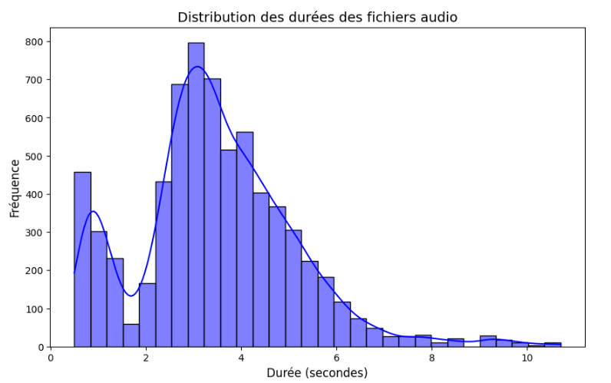
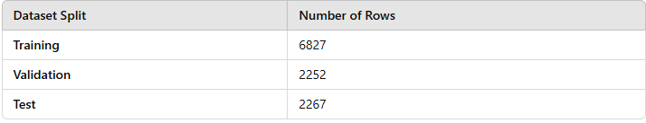
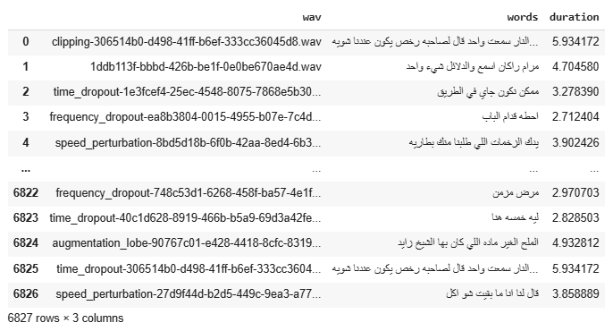
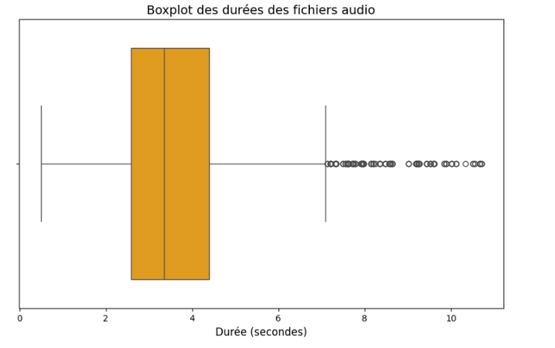
EDA (Exploratory Data Analysis)

Slide 6
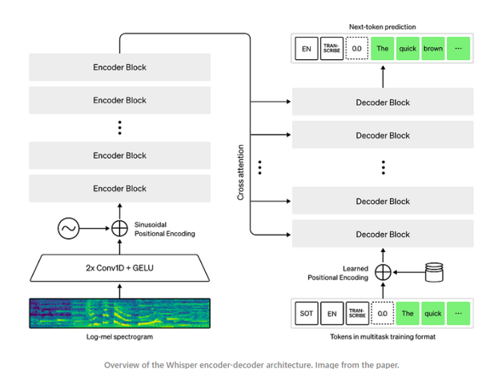
Whisper architecture

Slide 7

Choice of WHISPER for Fine-Tuning
Why Choose WHISPER for Fine-Tuning?
Multilingual Support:
Pre-trained on a diverse range of languages and dialects.
Accuracy on Non-Standard Speech:
Well-suited for handling regional accents and noisy speech, typical of Darija.
Flexibility:
Suitable for fine-tuning on a domain-specific dataset like MDVC.
State-of-the-Art Performance:
WHISPER has shown competitive results across various speech recognition benchmarks.

Slide 8
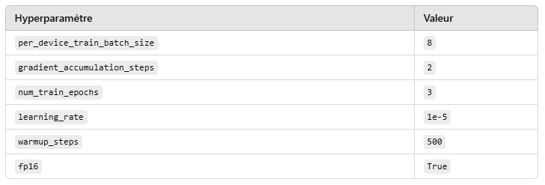
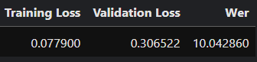
Fine-Tuning the Model

Slide 9
Model Evaluation
Evaluation Metrics:
Word Error Rate (WER): Measure of recognition accuracy Is 10%
Qualitative Analysis: A manual review of randomlyselected transcriptions was conducted.

Slide 10

DEMO

Slide 11

THANK YOU

Slide 12
Model Evaluation
Evaluation Metrics:
Word Error Rate (WER): 10%
This indicates that the model's transcription accuracy is 90%, with only 10% of words being inaccurately transcribed.
Qualitative Analysis:
A manual review of randomly selected transcriptions was conducted to assess transcription quality, ensuring that the results meet the desired standards.
Overview of WHISPER
WHISPER is a transformer-based model designed for speech recognition.
Known for its multilingual capabilities and robust performance on diverse datasets.
Key Features of WHISPER
Can handle noisy speech data.
Works well with multilingual and multi-accented speech recognition tasks.
Architecture Components
Encoder: Processes the speech input (audio waveform).
Decoder: Transforms the encoded information into text.
Attention Mechanisms: Ensure efficient contextual understanding of speech.

